Slide 1
Elemental Spectra
Pearson 3.4-3.5
Lucarelli 2.10

Slide 2
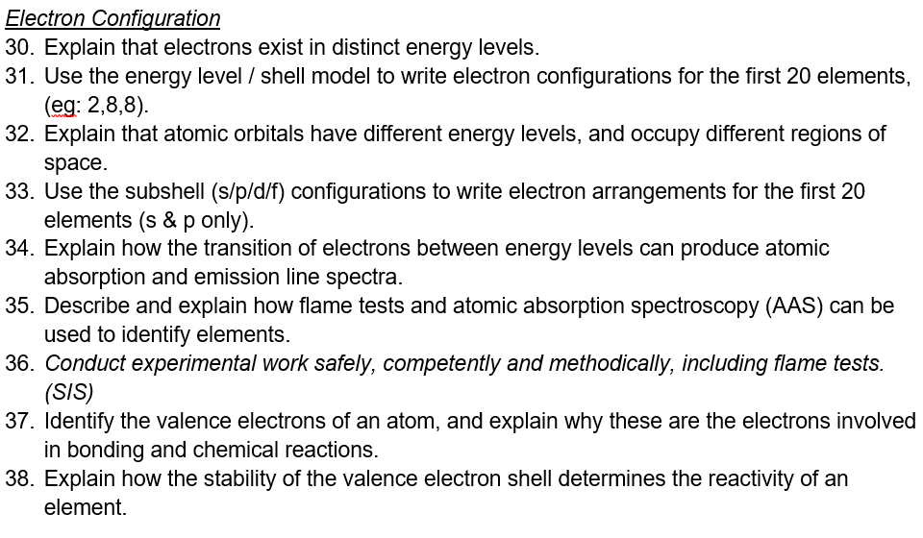

Slide 3
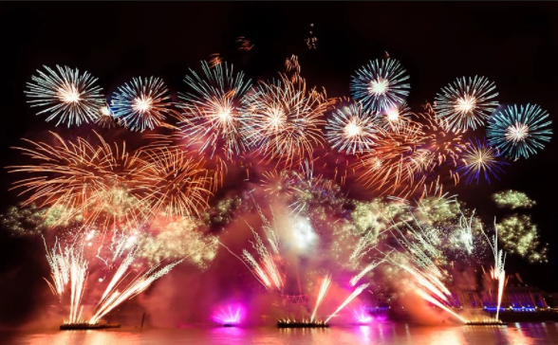
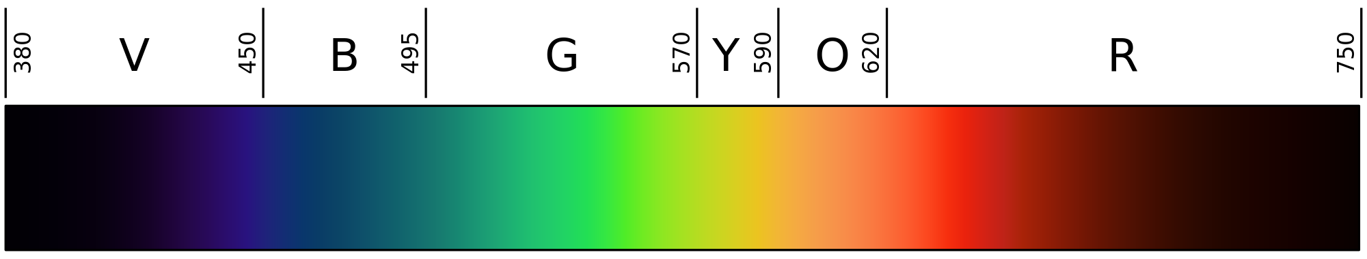
The Visible Spectrum

Slide 4
Electron shells
What is the electron subshell configuration for He?
What is the electron subshell configuration for S?
**What is the electron subshell configuration for Cr²⁺?**
Circle the valence electrons for each!

Slide 5
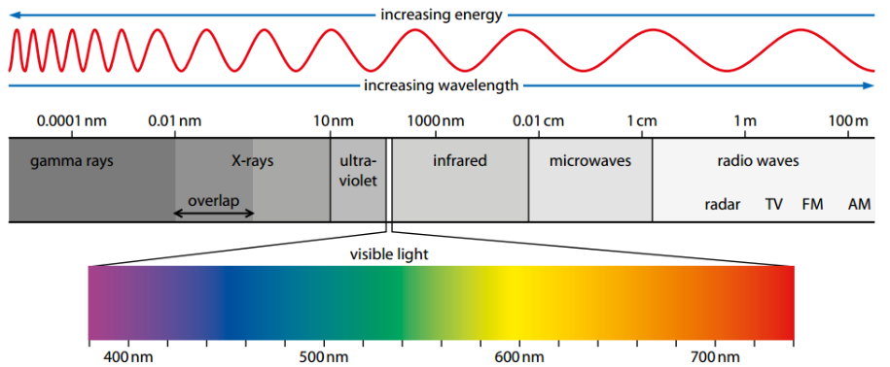

Slide 6
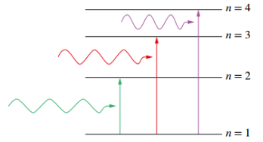

Slide 7
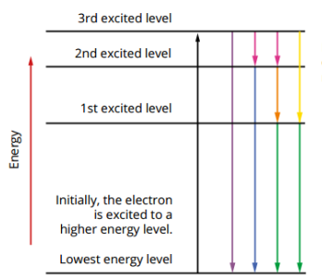

Slide 8
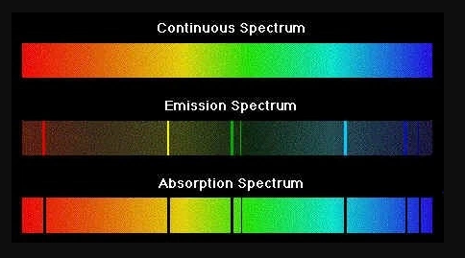
Absorption and Emission

Slide 9
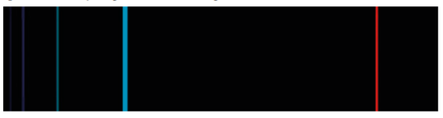
Hydrogen emission
Why are there multiple emission lines?

Slide 10
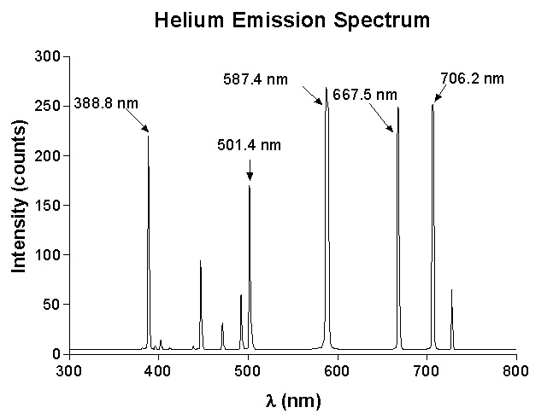
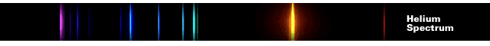

Slide 11
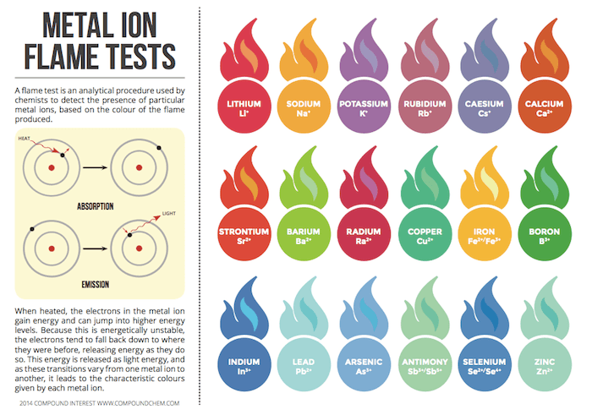

Slide 12
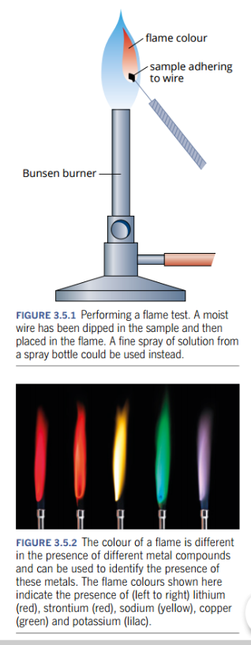
Flame Tests
Why does each element have a different coloured flame?
Is this quantitative or qualitative data?
What are the pitfalls of this test?
Notes:
https://www.youtube.com/watch?v=jJvS4uc4TbU

Slide 13
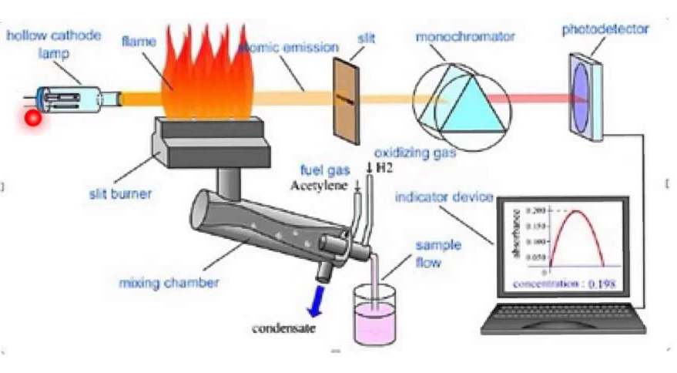
AAS (Qualitative and Quantitative)

Slide 14
Atomic Absorption Spectroscopy (AAS)
Related to emission spectroscopy
Used for quantitative analysis
Determine element to be analysed
Use a lamp of specific wavelength emission
Sample is vapourised and passed through a flame
The atoms of the element absorb the light
Any unabsorbed light waves pass through the flame to monchromator and then a detector
Absorbance value = light emitted – light detected

Slide 15
Practice
Pearson 3.4 and 3.5
Pearson Chapter 3 Review
Lucarelli 2.10 and Set 3
STAWA Experiment 8 and Experiment 9

